Slide 1
Automated Infrastructure management in Cloud for Distributed Task Execution

Slide 2
Motivation
Primary
Building automated infrastructure management in cloud for distributed task execution
Keep track of infrastructure according to process workloads
Secondary
Make it simple for beginner

Slide 3
Challenges
Get a LAB Environment.
Installing OpenStack smoothly
on different OS (Centos 7, Ubuntu 16.04LTS)
on different Hardware
on Google-Cloud
Building network connectivity
on different OS (Centos 7, Ubuntu 16.04LTS)
on different Hardware
on Google-Cloud

Slide 4
Bring clarity and provide guidance for various options
What is cloud?
01
What is OpenStack?
02
Why only OpenStack?
03
How to build OpenStack?
04
How to configure network easily in OpenStack?
05
Can I just submit my job or not?
06

Slide 5
Bring clarity and provide guidance for various options
What is cloud?
What is OpenStack?
Why only OpenStack?
How to build OpenStack?
How to configure network easily in OpenStack?
Can I just submit my job or not?

Slide 6
Cloud
Cloud computing is a model for enabling convenient, on-demand network access to a shared pool of configurable computing resources that can be rapidly provisioned and released with minimal management effort or service provider interaction.
On-demand self-service
Broad network access
Resource pooling
Rapid elasticity
Measured Service

Slide 7
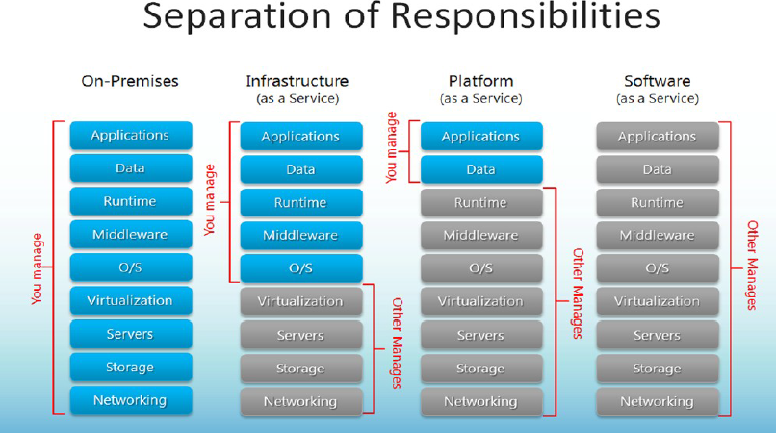

Slide 8
Bring clarity and provide guidance for various options
What is cloud?
What is OpenStack?
Why only OpenStack?
How to build OpenStack?
How to configure network easily in OpenStack?
Can I just submit my job or not?

Slide 9
OpenStack
OpenStack is a cloud operating system that provides IaaS which controls large pools of compute, storage, and networking resources throughout a data center
All managed through a dashboard that gives administrators control while empowering users to provision resources through a web interface
OpenStack Release history
https://wiki.OpenStack.org/wiki/Releases
With every new release of OpenStack, new services are released. Refer to http://www.OpenStack.org/software/ for latest software / services available

Slide 10
OpenStack Distribution
Red Hat Enterprise Linux OpenStack Platform
Canonical Distribution of Ubuntu OpenStack
SUSE Cloud(SUSE OpenStack)
Rackspace Private Cloud
HP Helion Private Cloud
Mirantis OpenStack
VMware Integrated OpenStack

Slide 11
OpenStack Services
  Horizon – Dashboard
  Keystone – Identity service
  Glance – Image service
  Heat – Orchestration service
  Nova – Compute service
  Neutron – Network service
  Cinder – Block Storage service

Slide 12
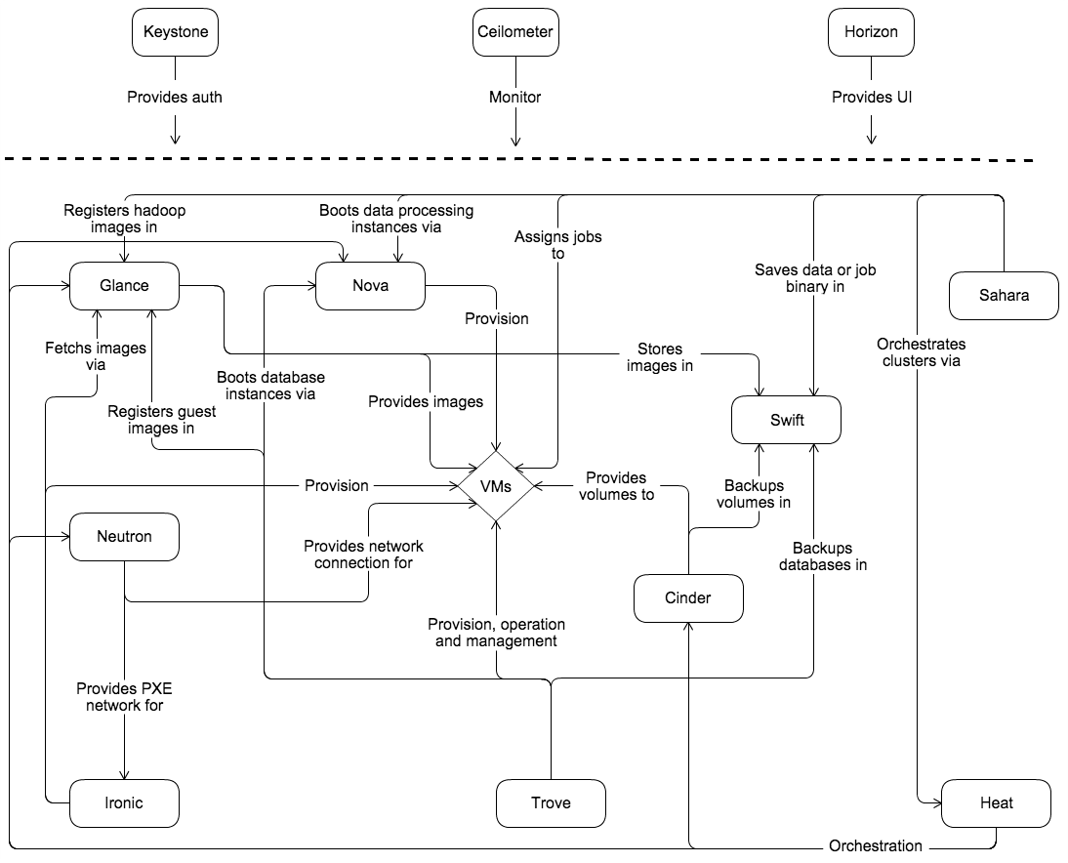
OpenStack Services inter-connectivity

Slide 13
Bring clarity and provide guidance for various options
What is cloud?
What is OpenStack?
Why only OpenStack?
How we build OpenStack?
How to configure network easily in OpenStack?
Can I just submit my job or not?

Slide 14
How we build OpenStack
Installed Ubuntu on physical/virtual server
01
Downloaded devstack from git repository
02
Created stack user with sudo privilidges
03
Login locally with stack user with ssh
04
Installed OpenStack
05

Slide 15
Bring clarity and provide guidance for various options
What is cloud?
What is OpenStack?
Why only OpenStack?
How to build OpenStack?
How to configure network easily in OpenStack?
Can I just submit my job or not?

Slide 16
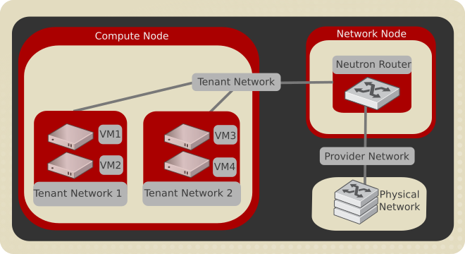

Slide 17
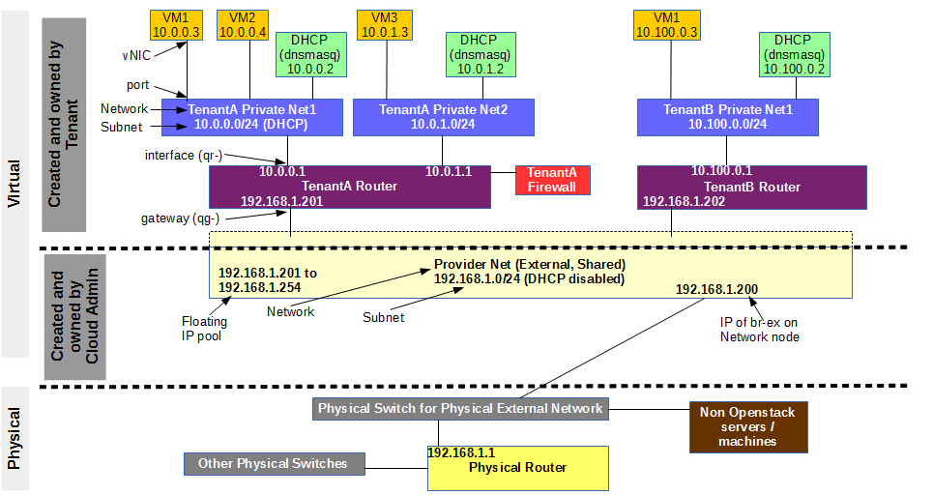

Slide 18
Bring clarity and provide guidance for various options
What is cloud?
What is OpenStack?
Why only OpenStack?
How we build OpenStack?
How to configure network easily in OpenStack?
Can I just submit my job or not?

Slide 19
Server1
(Scheduler)
Executor1
Socket Connection
Client
RabbitMQ
Server2
(Scheduler)
MySQL
Executor2
Server3
(Scheduler)
Executor3
Asynchronous Execution

Slide 20
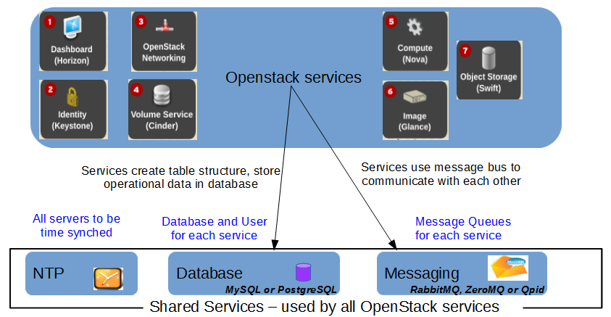
Supporting services for OpenStack

Slide 21
Literature Review on OpenStack Scheduling

Slide 22
An OpenStack-based resource optimization scheduling framework
Analyzes the current mainstream open-source OpenStack cloud platform resource scheduling mechanism, and proposes an extensible resource optimization scheduling framework based on OpenStack (Resource Polls)
Publisher: IEEE
Published in: Computational Intelligence and Design (ISCID), 2013 Sixth International Symposium
IEEE Xplore: 24 April 2014

Slide 23
Network-aware Instance Scheduling in OpenStack
Presenting an extension of the OpenStack scheduler that enables a network-aware placement of instances by taking into account bandwidth constraints to and from nodes. (Bandwidth and QoS)
Publisher: IEEE
Published in: Computer Communication and Networks (ICCCN), 2015 24th International Conference
IEEE Xplore: 05 October 2015

Slide 24
Introducing Network-Aware Scheduling Capabilities in OpenStack
Motivates and describes the introduction of network-aware scheduling capabilities in OpenStack, the open source reference framework for creating public and private clouds. NFV and SDN -2015
Publisher: IEEE
Published in: Network Softwarization (NetSoft), 2015 1st IEEE Conference
IEEE Xplore: 04 June 2015

Slide 25
Improved Filter-weight Algorithm for Utilization-aware Resource Scheduling in OpenStack
Improved nova-scheduler is referred as metrics-weight scheduler – vcpu and network bandwidth
Publisher: IEEE
Published in: Information Processing (ICIP), 2015 International Conference
IEEE Xplore: 13 June 2016

Slide 26
Self-Healing Redundancy for OpenStack Applications through Fault-Tolerant Multi-agent Task Scheduling:
OpenStack does not provide high availability at application and VM (Virtual Machine) level - 2016
Publisher: IEEE
Published in: Cloud Computing Technology and Science (CloudCom), 2016 IEEE International Conference
IEEE Xplore: 26 January 2017

Slide 27
Technical Document from Intel
Utilization Based Scheduling in OpenStack Compute (Nova) - 2017
https://01.org/openstack/downloads/utilization-based-scheduling-openstack-compute-nova

Slide 28
Future Work
Conclusion
Add all capabilities to our task execution framework as proposed in research papers so that scaling up and scaling down of VMs will be optimized based on considering all resources utilization

